Slide 1
Cystic Neoplasms of the Pancreas
Donald W. Weaver, M.D.
Penberthy Professor of Surgery and Chairman
Wayne State University
Department of Surgery
Detroit, Michigan

Slide 2
Clinical Features
Majority of pancreatic cysts are incidentally detected i.e. they are asymptomatic.
Symptomatic cysts are most likely to manifest with abdominal pain.
Jaundice or recurrent pancreatitis often indicates that the lesion is either in communication with the pancreatic ductal system or obstructing the pancreatic or biliary duct.
Pseudocysts typically occur with acute pancreatitis or may develop insidiously in the setting of chronic pancreatitis.

Slide 3
Classification of Cystic Pancreatic Lesions
Pseudocyst
Common cystic pancreatic neoplasms
  Serous cystadenoma
  Mucinous cystic neoplasm
  IPMN
Rare cystic pancreatic neoplasms
  Solid pseudo papillary tumor
  Acinar cell cystadenocarcinoma
  Lymphangioma
  Hemangioma
  Paraganglioma

Slide 4
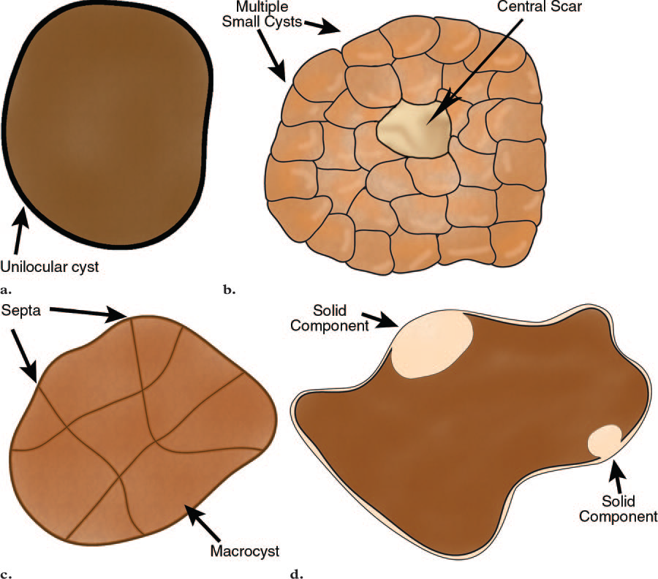
Four Morphologic Types of Cystic Lesions of the Pancreas

Slide 5
CYSTIC NEOPLASMS
The diagnosis of a cystic neoplasm should be considered when there is no history of pancreatitis or trauma.
Morphological characteristics of a cystic neoplasm are:
  thick irregular rim,
  septations
  solid components
  dilated pancreatic duct > 3mm and calcifications.
Fluid aspirated from a cyst with an HIGH amylase level
Fluid aspirated from a cyst with CEA>200
It is important to make the diagnosis of a serous cystic neoplasm, since this is the only tumor that has no malignant potential.

Slide 6
Microcystic Lesions-Serous cystadenoma
Benign tumor, but large tumors have a tendency to increase in size and cause symptoms.
Typically seen in 'Grandma' .
Microcystic or honey-combed cyst with central scar (30%) and calcifications (18%)
Macrocystic in 10% and difficult to differentiate from pseudocyst and mucinous cystic neoplasm .
Lobulated surface .
No communication between cysts and pancreatic duct.
Hypervascular enhancement is sometimes seen and can look like cystic neuroendocrine tumor

Slide 7
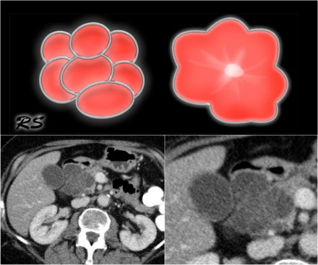
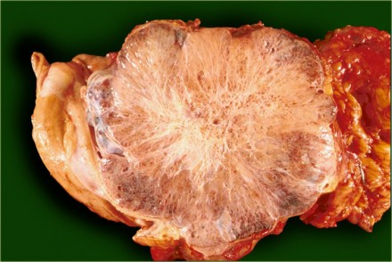
Serous cystadenoma

Slide 8
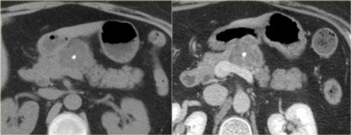
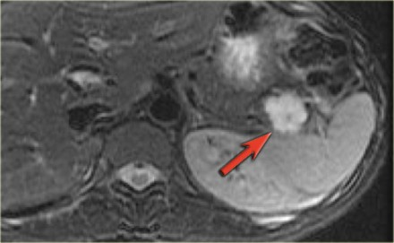
Serous cystadenoma-cont..
Hypodense lesion with central calcification&enhancement of septae
T2WI fatsat shows a lobuated hyperintense lesion with central scar,characteristic of SCN.

Slide 9
Serous cystadenoma
(macrocystic variant)

Slide 10
Macrocystic Lesions
Mucinous cystic neoplasms
Intraductal Papillary Mucinous Neoplasm (IPMN)

Slide 11
MUCINOUS CYSTIC NEOPLASMS
Premalignant tumor - may transform into a mucinous cystadenocarcinoma
Exclusively seen in women - Typically in 'Mother' - median age: 40-50 years
Macrocystic with thick wall septations and peripheral calcifications
Peripheral calcifications seen in 25%. This finding allows you to make a specific diagnosis
Location in the tail and body of the pancreas (95%).
Most are symptomatic, presenting with nondescript abdominal pain

Slide 12
Mucinous cystadenoma manifesting as a multiseptated cyst

Slide 13
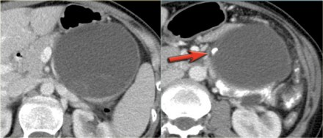
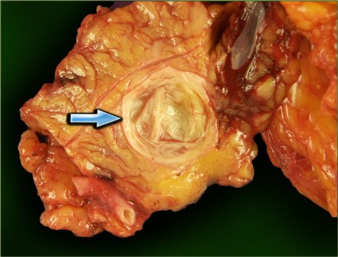
MUCINOUS CYSTIC NEOPLASMS (cont..)

Slide 14
Mucinous cystadenoCARCINOMA

Slide 15
D/D b/w Mucinous cystadenoma and CARCINOMA
Mucinous cystadenocarcinoma manifest at MR imaging as large complex cystic pancreatic lesions.
They may be distinguished from Mucinous cystadenoma by the presence of intracystic enhancing soft tissue.
Hence, any enhancing soft tissue within a cystic neoplasm depicted on MR images is considered an indication for resection

Slide 16
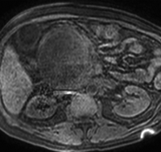
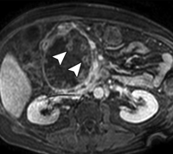
D/D b/w Mucinous cystadenoma and CARCINOMAD/D b/w Mucinous cystadenoma and CARCINOMA (cont..)
Contrast-enhanced MR images show enhancing mural soft-tissue elements projecting toward the cyst center.
Axial T2-weighted MR image shows a large, complex cystic lesion in head

Slide 17
Intraductal Papillary Mucinous Neoplasm
Mucin producing tumor in main pancreatic duct or branch-duct.
Location: pancreatic head >> tail and corpus.
Must have communication with pancreatic duct.
Best seen with MRCP.
Can be multifocal.
Main-duct IPMN has imaging features distinct from branch-type.
Branch-duct type can look like other cystic neoplasms

Slide 18
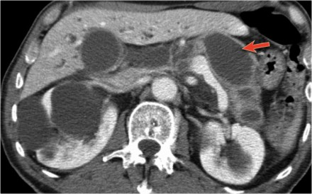
Intraductal Papillary Mucinous Neoplasm..Main duct type..
Extremely widened main pancreatic duct (red arrow).

Slide 19
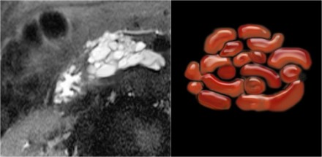
Intraductal Papillary Mucinous Neoplasm..Branch duct type..
"Multicystic" lesion in uncinate process/head contiguous with dilated MPD("grape-like"
clusters or tubes & arcs)

Slide 20
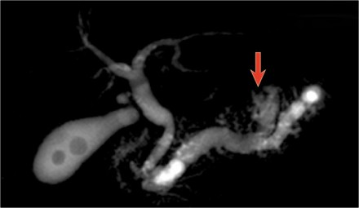
Intraductal Papillary Mucinous Neoplasm..
SOMETIMES THERE IS A MIXED TYPE.
THE MRCP SHOWS BOTH A MAIN-DUCT AS WELL AS A BRANCH-DUCT IPMN (ARROW).

Slide 21
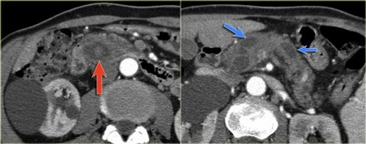
Intraductal Papillary Mucinous Neoplasm..MALIGNANT
Signs of malignancy are:
Pancreatic duct > 8 mm
Solid node in duct.
Mass around the pancreatic duct.
Enlarged bile duct.

Slide 22
Cysts with a solid component
Unilocular or multilocular
True cystic tumors or solid pancreatic neoplasms with cystic component/degeneration
Wide DDx
  Mucinous cystic neoplasms
  IPMNs
  Islet cell tumor
  Solid pseudopapillary tumor (SPEN)
  Adenocarcinoma
  Metastasis
All malignant or have a high malignant potential
Surgical management

Slide 23
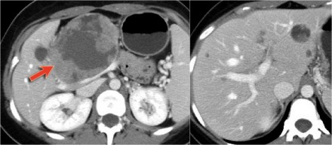
Solid pseudopapillary tumor manifesting as a cyst with a solid component
Very uncommon neoplasm seen in women 20-30 years (Daughter).
Solid and cystic neoplasm with capsule and with early 'hemangioma-like' enhancement. Sometimes intratumoral hemorrhage

Slide 24
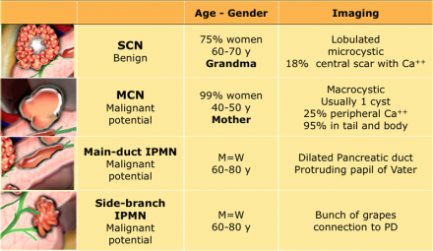
NEOPLASMS IN NUTSHELL

Slide 25
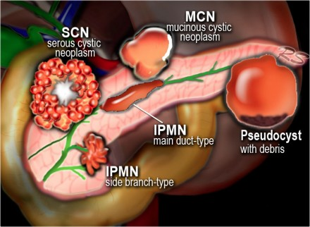
MORPHOLOGY

Slide 26
Pearls
Age & Gender
  “Daughter Lesion”: SPEN
  “Mother Lesion”: Mucinous cystic
  “Grandmother Lesion”: Serous cystadenoma
Location
  Head/neck for serous & side branch IMPN
  Body/tail for mucinous cystic neoplasm
Calcification
  Peripheral in mucinous cystic
  Central in serous cystadenoma
Mural Nodularity (enhancement = neoplasm)
Duct communication (narrow neck) favors IPMN

Slide 27
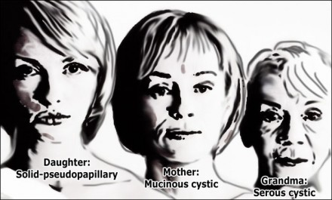
TAKE HOME …☺☺

Slide 28
Conclusion
Cystic Neoplasms of the pancreas are uncommon but with the advent of advanced diagnostic imaging we are fiinding an increasing number
Differentiation between neoplasm and pseudocyst cannot be overemphasized
Surgical excision is the mainstay of therapy
Excellent long-term survival can be expected

